Slide 1
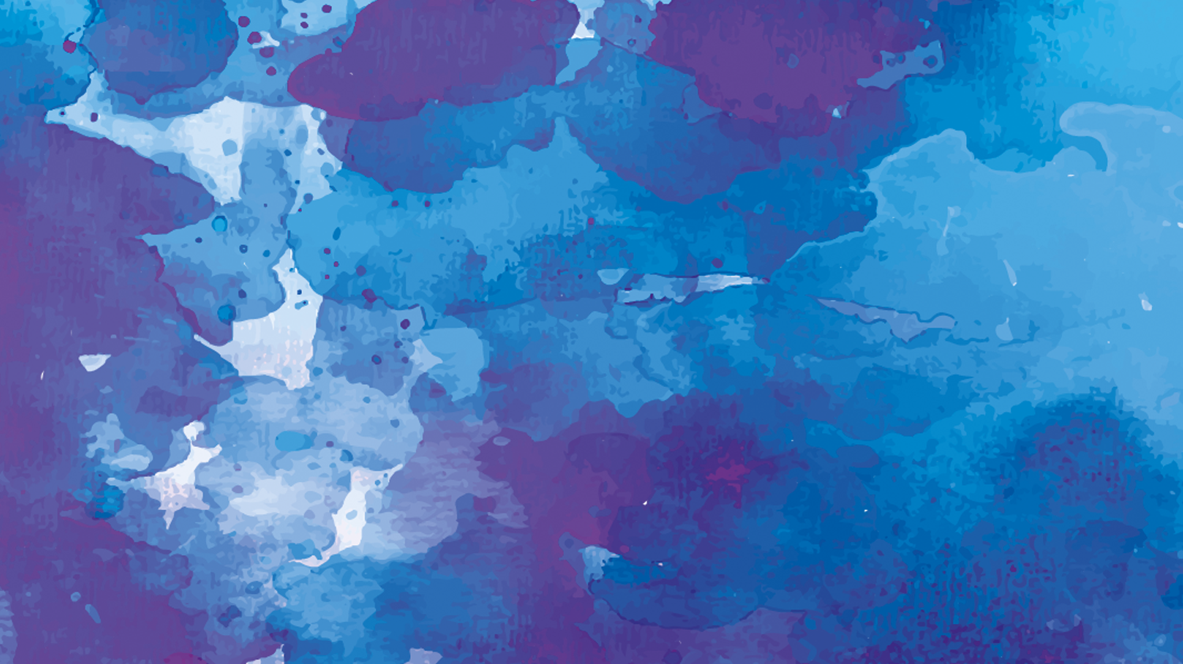
Transmigration
Gate
2018 SoC Summer Workshop
Group 55
PAN CHANGJIE
WU MENGQI
ZHU HONGJIN
Notes:
good afternoon everyone it is my great honor to stand here and share my project with you. We are group 55, (自己说名字）

Slide 2
CONTENTS
Purpose
Related Work
1
2
Pipeline & Final work
Weakness & Improvement
3
4
Notes:
Our final work is a photo filter which can change photographs to painting,I will introduce our project from those

Slide 3
1
Purpose

Slide 4
Purpose
1
Further understanding Fourier Transform and color space
2
Pursuing the art
3
The combination of photography and painting
4
Learn with fun
Notes:
We want to have better understanding of ft and different color space such as:
1.Color space include: RGB HSV LAB
actually, we have done lots of work but we do not use all of them in our final work, what we want most is pursuing art, not just pile up algorithm
Third I want to combine photography with painting for I am interested in both of them.
Last but not least we should learn with fun!

Slide 5
2
Related Work

Slide 6
Related Work
Oil Painting
Blend Mode
Rotation
Embossment
Color space
Outline
Fourier Transform
Smash Filter
Notes:
Here I will introduce some related work in detail

Slide 7
Related Work
Oil Painting
Using Brush painting on paper
Colors change more abruptly than photograph
High saturation
Notes:
Before talking about algorithm, we should think about that: what is the feature of oil painting, we use different brush to paint on paper brush has different size and hardness paper has their special texture. Oil painting using has high saturation

Slide 8
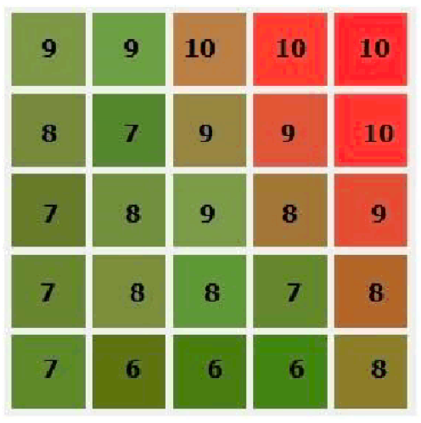
Related Work
Oil Painting
Intensity: (r+g+b)/3*20/255
Intensity bin
Add paper texture
Notes:
In order to imitate the brush, we introduce a concept: intensity, which is calculated as above equation, and 20 is defined as intensity level which can be changed.
To get a pixels final rgb color, we need to calculate all pixels intensity within the radius, and use the average color of the pixels whose intensity appear most times in the intensity bin. adjacency
Fiinally we add paper texture to the images.

Slide 9
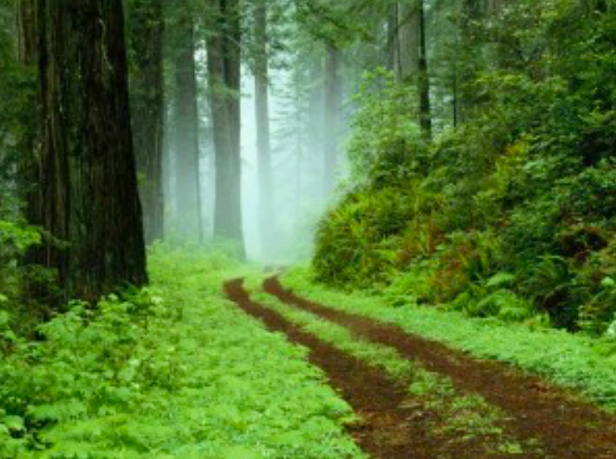
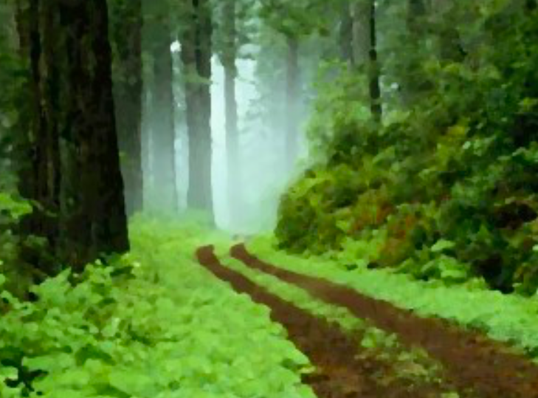
Related Work
Oil Painting
Before
After

Slide 10
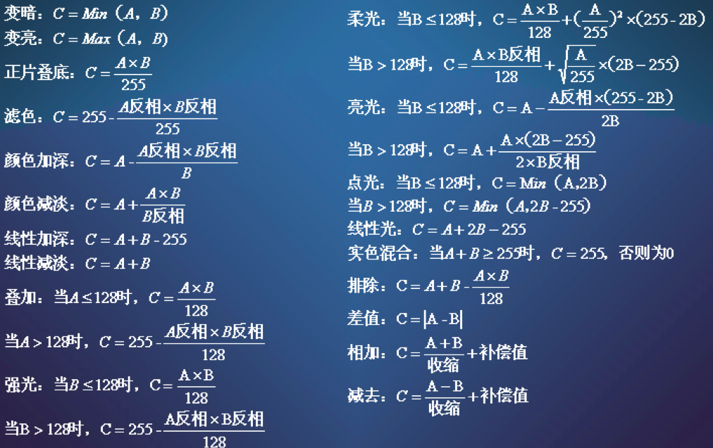
Related Work
Blend Mode
How two layers being merged
Notes:
You may be confused : how I add one image’s texture to another image, I am going to explain it now. it is called blend mode, there are many blend modes and different mode has different feature, they calculate the final rgb value by differnent combination of previce two, you can find this information online.

Slide 11
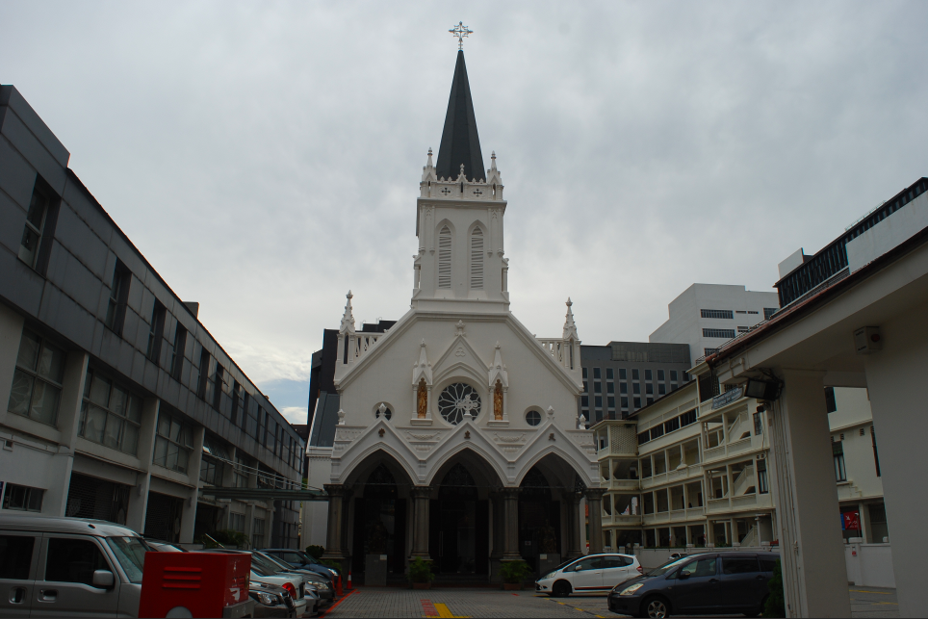
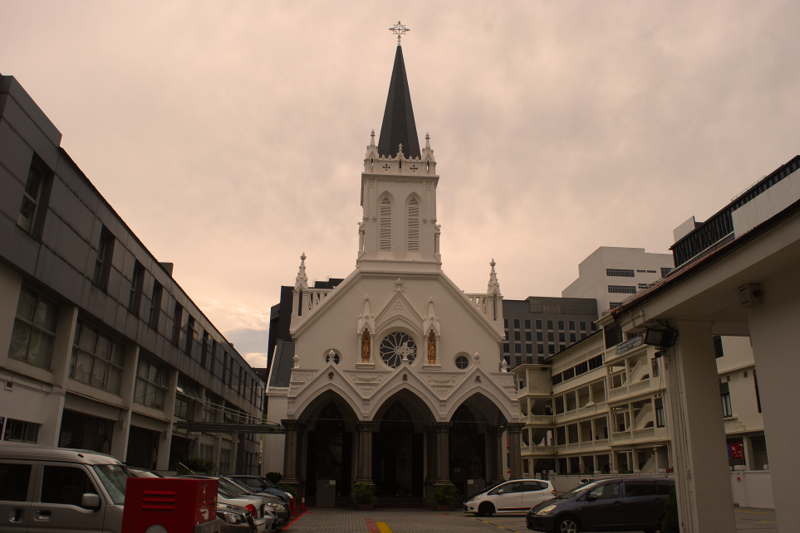
Related Work
Blend Mode
Before
After
Notes:
The left is the originla pic and I add an orig layers on it by mutiply pic color with orig and divided by 255

Slide 12
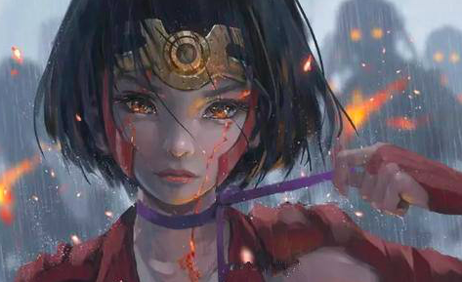
Related Work
Rotation
Phase * -1
Notes:
As we all know magnitude represent the signal’s intensity and phase represent the phase position of the signal, if we *-1with phase, we rotation the signal 180 degree from th e first quadrant to the third .and the picture will be roataed too

Slide 13
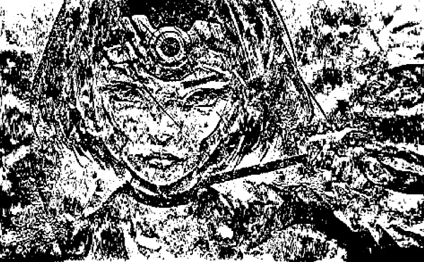
Related Work
Embossment
fft_image = fft(image);
Image = ifft(uint8(fft_image));
Notes:
Actually, I want to know how much of information can present the basic shape of the original pic, I use uint8（to make number which smaller than 0 or bigger than 255 to be zero）and do inverted fft. surprising, the output image like an embossment ,do note that I use fft not fft2, if you use fft2, you will get a real mass I do think doing fft line by line will maitain more coordinate info

Slide 14
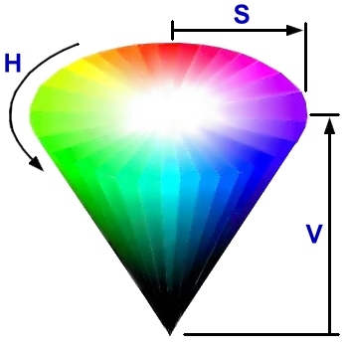
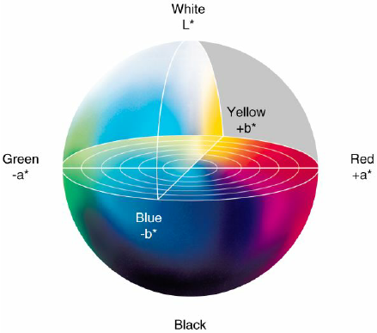
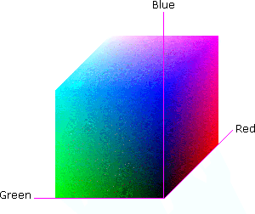
Related Work
Color Space
RGB HSV LAB

Slide 15
Related Work
Color Space
for each pixel (x,y) in image
if H(x,y)>90 && H(x,y)<270
S(x,y)=S(x,y)*2;
end
end
90 270
Hue(Green - Blue)
Saturation’s value double

Slide 16
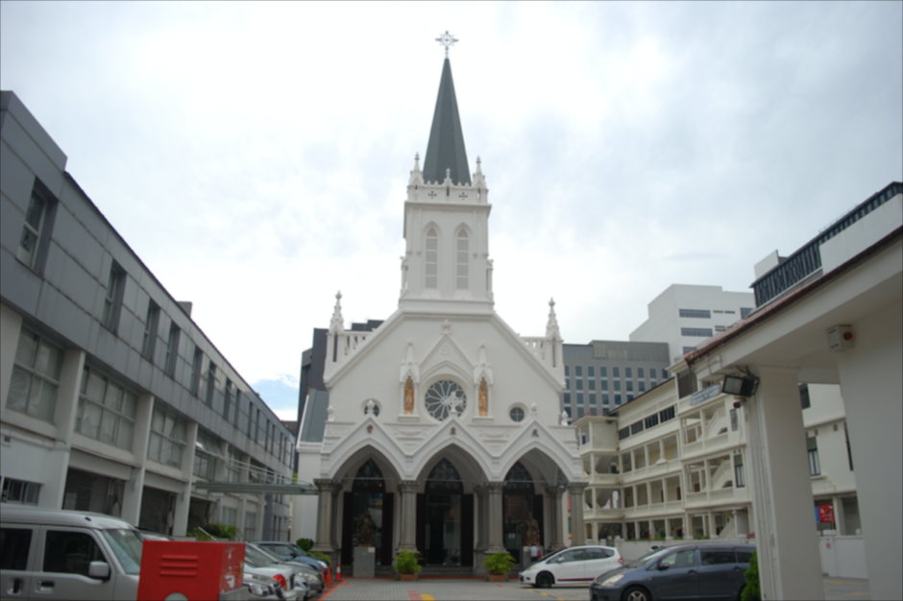
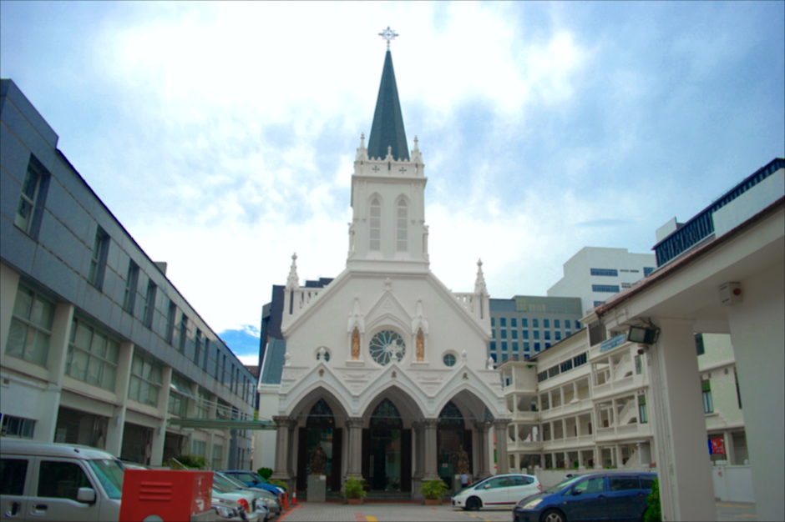
Related Work
Color Space
Before After

Slide 17
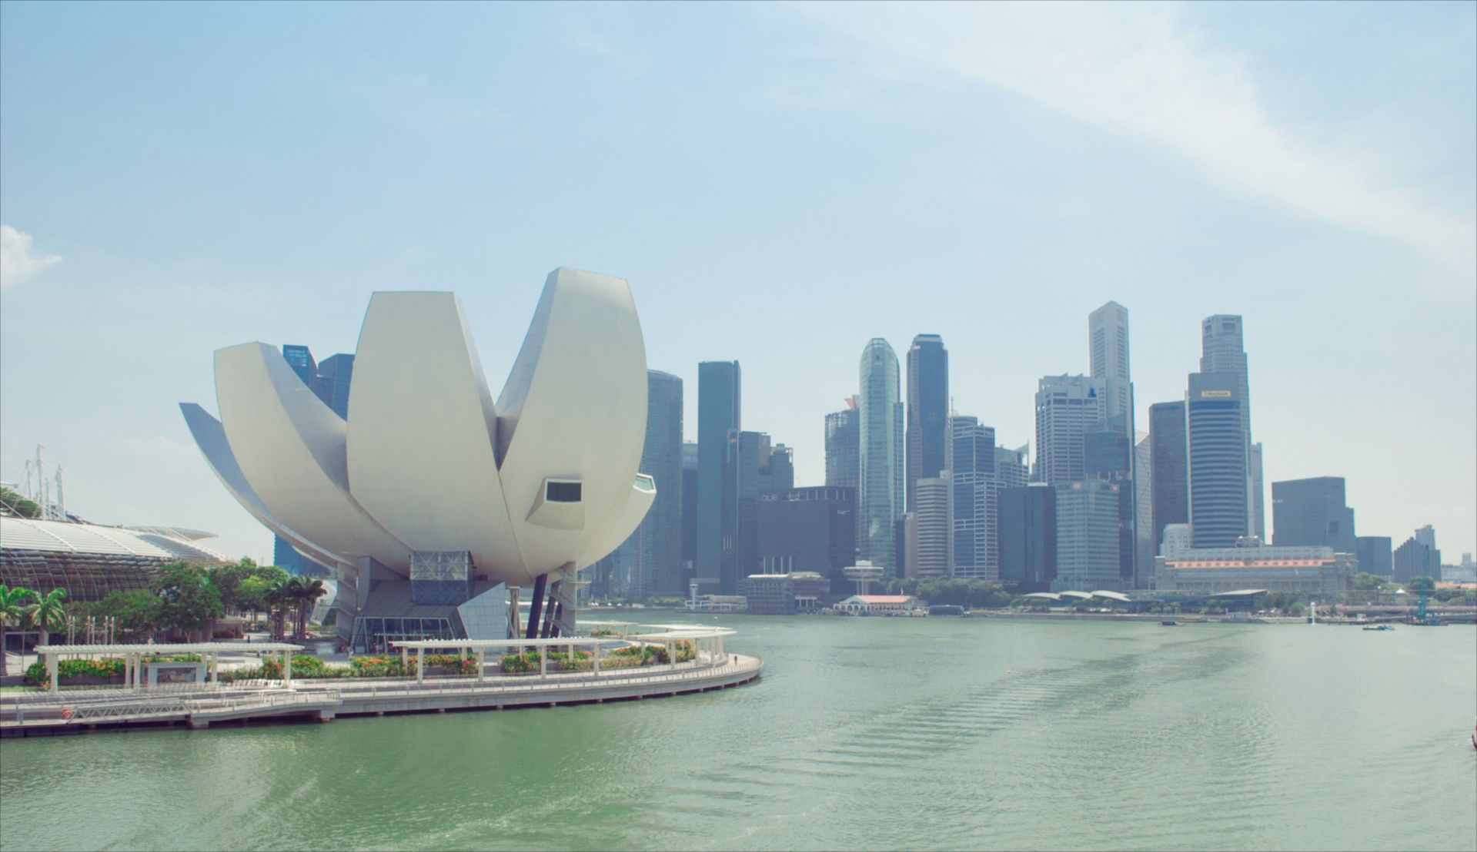
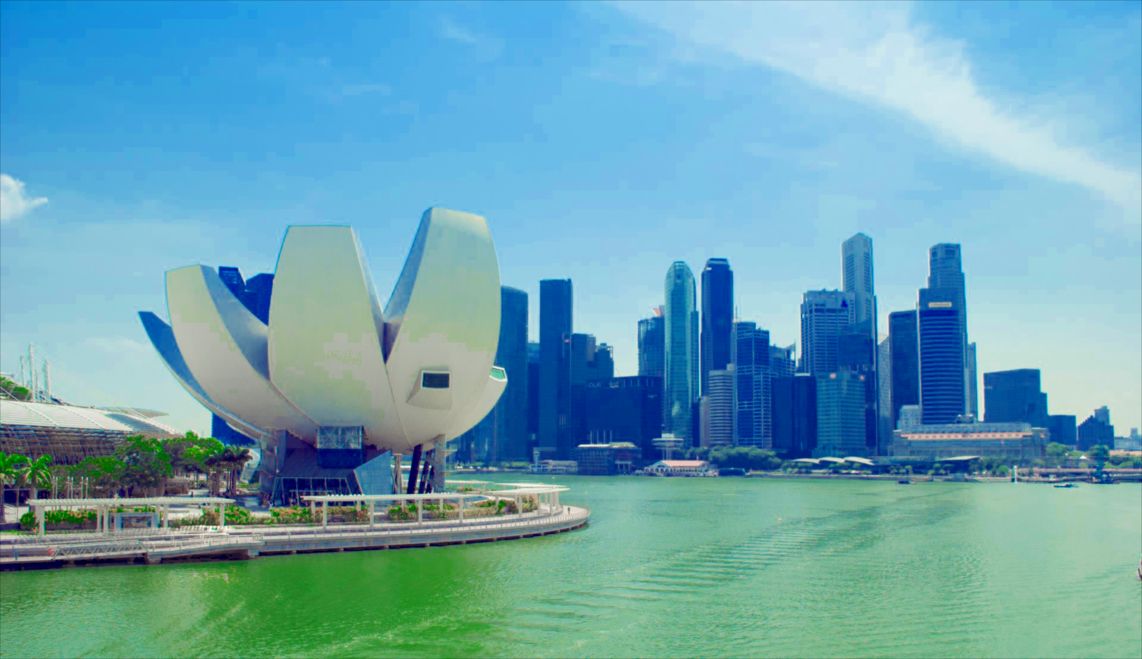
Related Work
Color Space
Before After

Slide 18
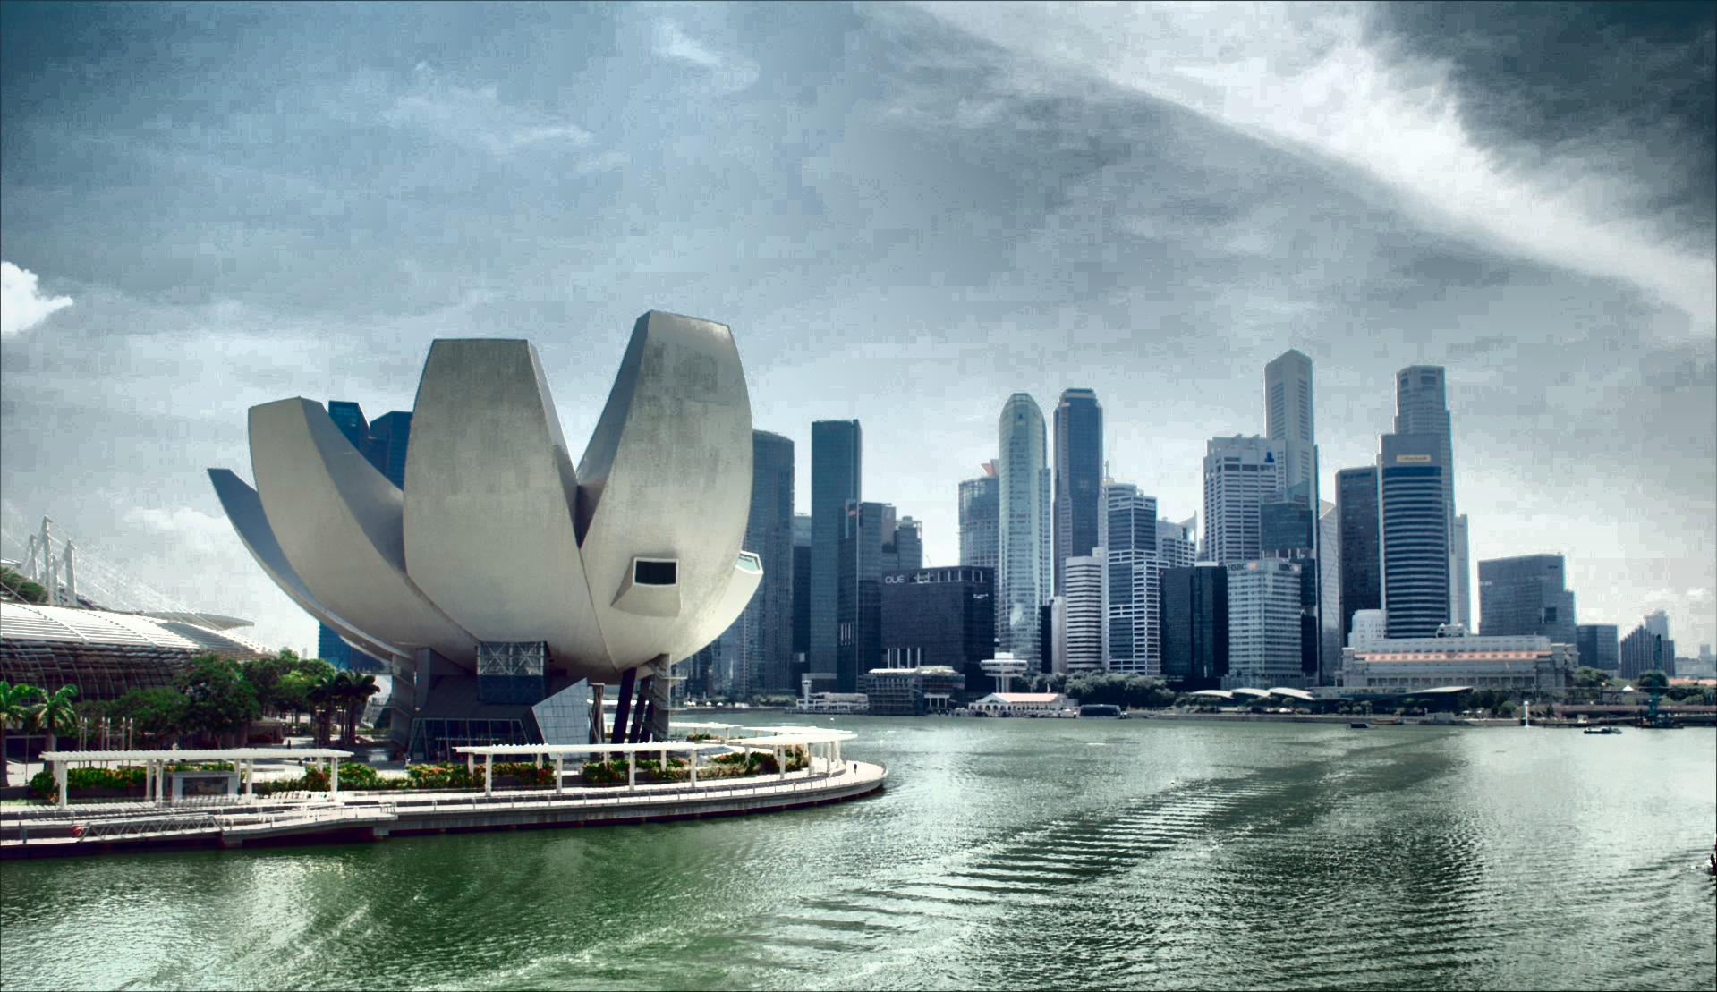
Related Work
Color Space
Dirty filter
Contrast-limited adaptive histogram equalization (CLAHE)
Before After
Notes:
More details in the image: see cloud clearly, wave clearly and building with shadow.

Slide 19
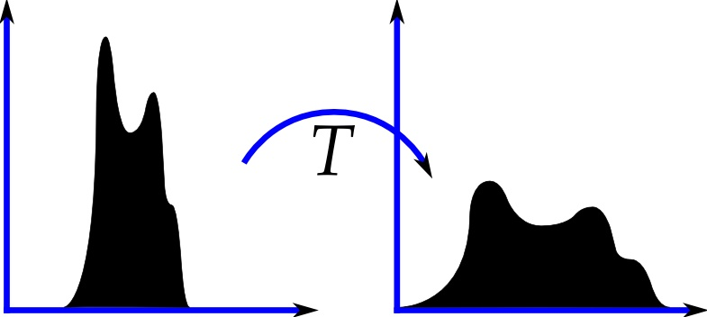
Related Work
Adaptive(Local) histogram equalization
Color Space
Block
Drawback:
Tend to produce noise,
if pixels in block is almost uniform
Image matrix
Notes:
AHE tends to overamplify the contrast in block of the image, the histogram in such regions is highly concentrated.

Slide 20
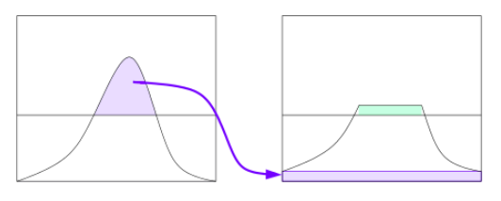
Related Work
Contrast-limited adaptive histogram equalization (CLAHE)
Color Space
Block
Image matrix
Clip out and redistribute
Notes:
CLAHE limits the amplification by clipping the histogram at a predefined value before computing the CDF.
It is advantageous not to discard the part of the histogram that exceeds the clip limit but to redistribute it equally among all histogram bins

Slide 21
Related Work
Color Space
LAB
Perceptually uniform
Do
CLAHE
in
L
L: Lightness channel
a: Red-green channel
b: Yellow-blue channel
Lightness
channel
Notes:
1.In HSV color space, hue is distributed uniformly along the disk of the cone. However, people have different sensitivity to the change of hue.
2. LAB is more perceptually uniform than HSV. Perceptually uniform means that a change of the same amount in a color value should produce a change of about the same visual importance in a,b channel. Adjust L channel has less influence to the tone of the image.

Slide 22
Related Work
Color Space
Dirty filter
Contrast-limited adaptive histogram equalization (CLAHE)
Before After
Notes:
The contrast enhanced greatly.

Slide 23
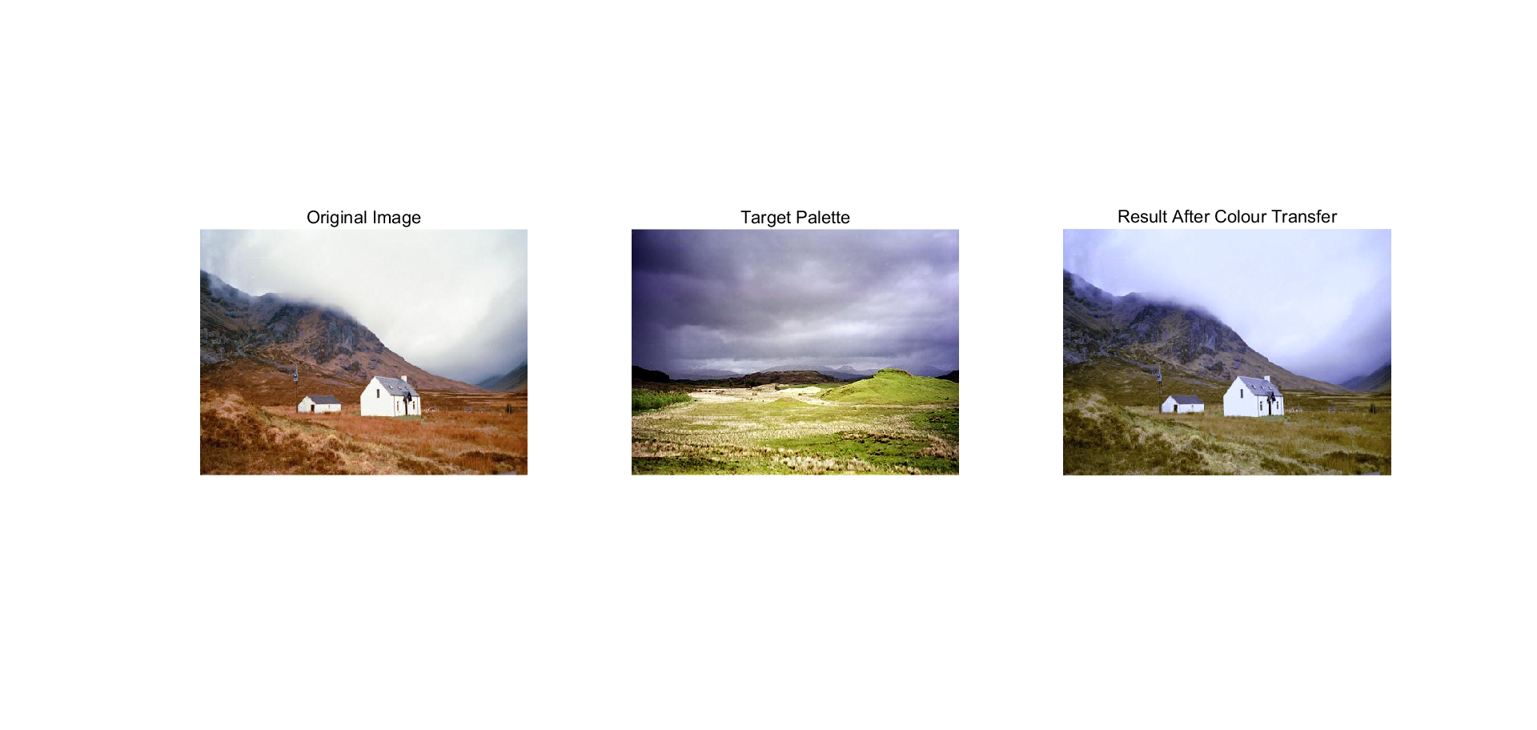
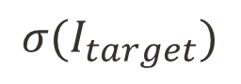
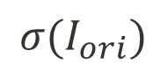
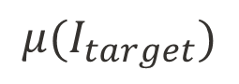
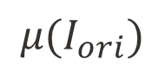

Related Work
Color transfer
Color space
$$μ{(I}_{ori})$$
$$μ{(I}_{target})$$
Same$μ,σ$ as $I_{target}$
$$σ{(I}_{ori})$$
$$σ{(I}_{target})$$

Slide 24
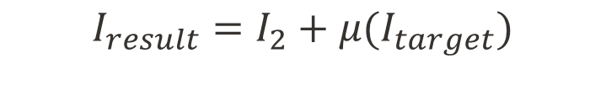
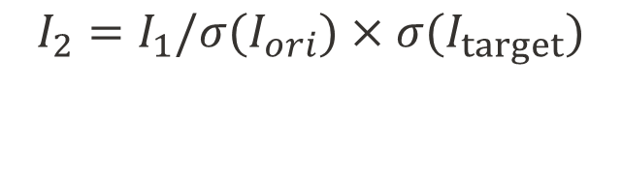
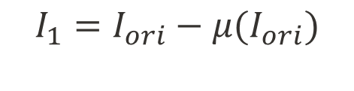

Related Work
Color transfer
Color space
Same$μ,σ$ as $I_{target}$
Step 1: Normalization.
Step 2: Change the std value.
Step 3: Change the mean value.
$$I_{1}=I_{ori}−μ{(I}_{ori})$$
$$I_{2}=I_{1}/σ{(I}_{ori})×σ{(I}_{target})$$
$$I_{result}=I_{2}+μ{(I}_{target})$$

Slide 25
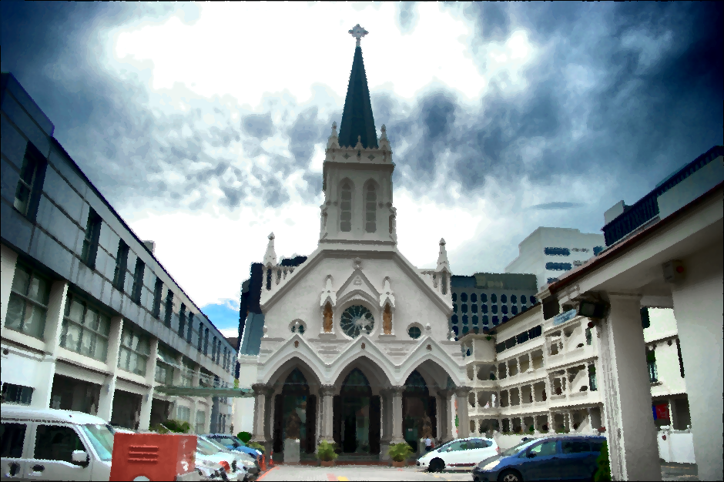
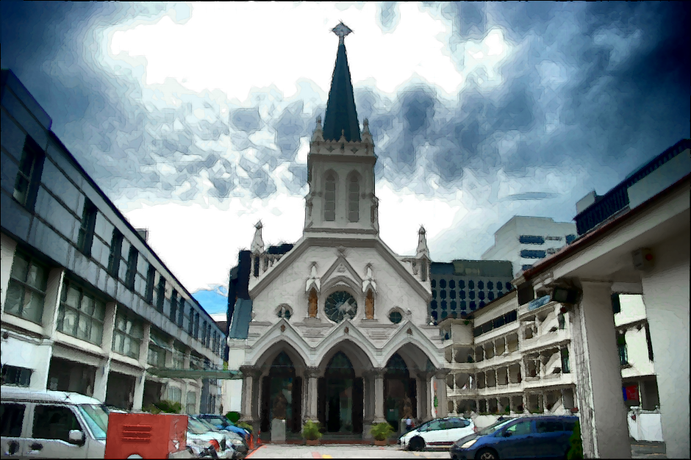
Related Work
Outline
Before After

Slide 26
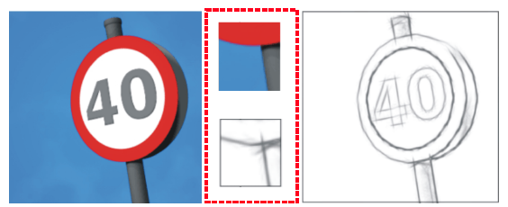
Related Work
Outline
Add stroke structure
Before After

Slide 27
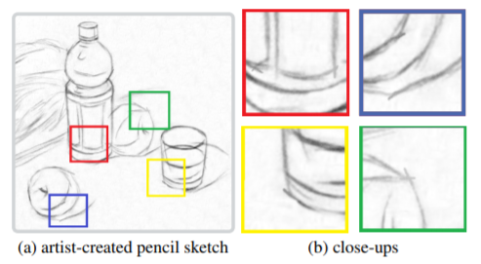
Related Work
Outline
1. No very long strokes
2. Stroke are in several specified directions

Slide 28
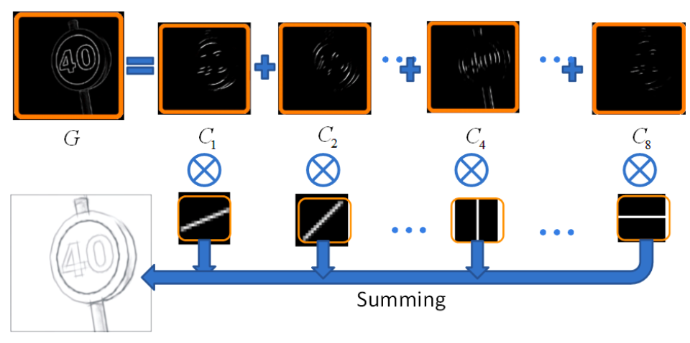
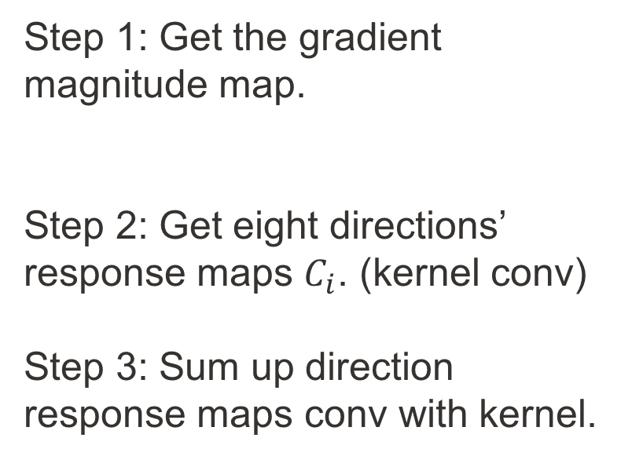
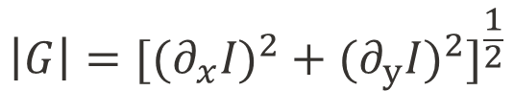
Related Work
Outline
Step 1: Get the gradient magnitude map.
Step 2: Get eight directions’ response maps $C_{i}$. (kernel conv)
Step 3: Sum up direction response maps conv with kernel.
$$\left|G\right|={[{{(∂}_{x}I)}^{2}+{{(∂}_{y}I)}^{2}]}^{\frac{1}{2}}$$
"Combining Sketch and Tone for Pencil Drawing Production" Cewu Lu, Li Xu, Jiaya Jia

Slide 29
Related Work
Fourier Transform
Adjust the frequency domain
Exchange the magnitude and phase

Slide 30
Related Work
Fourier Transform
Adjust the frequency domain

Slide 31
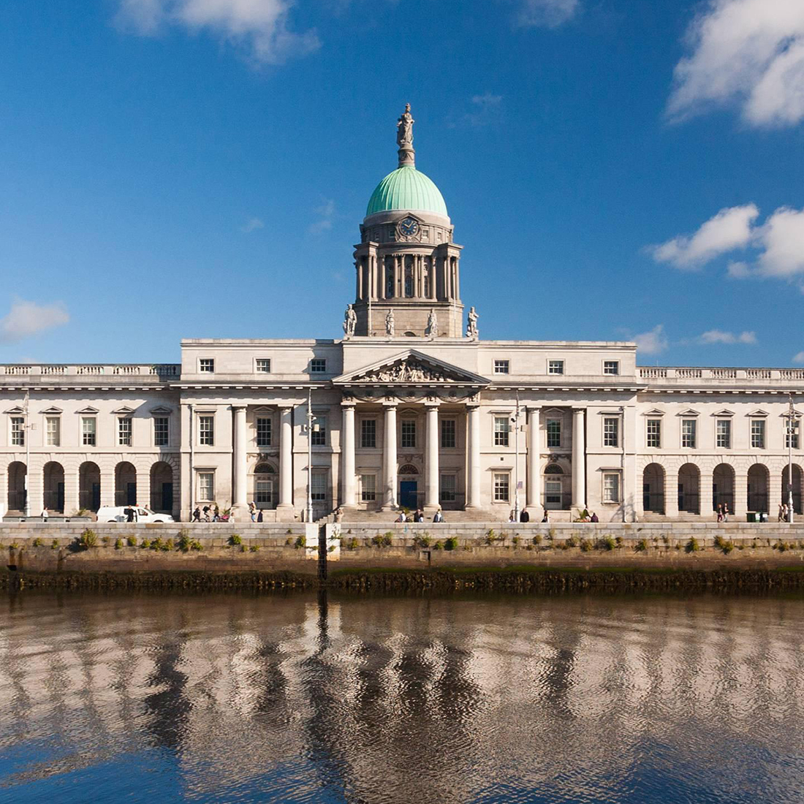
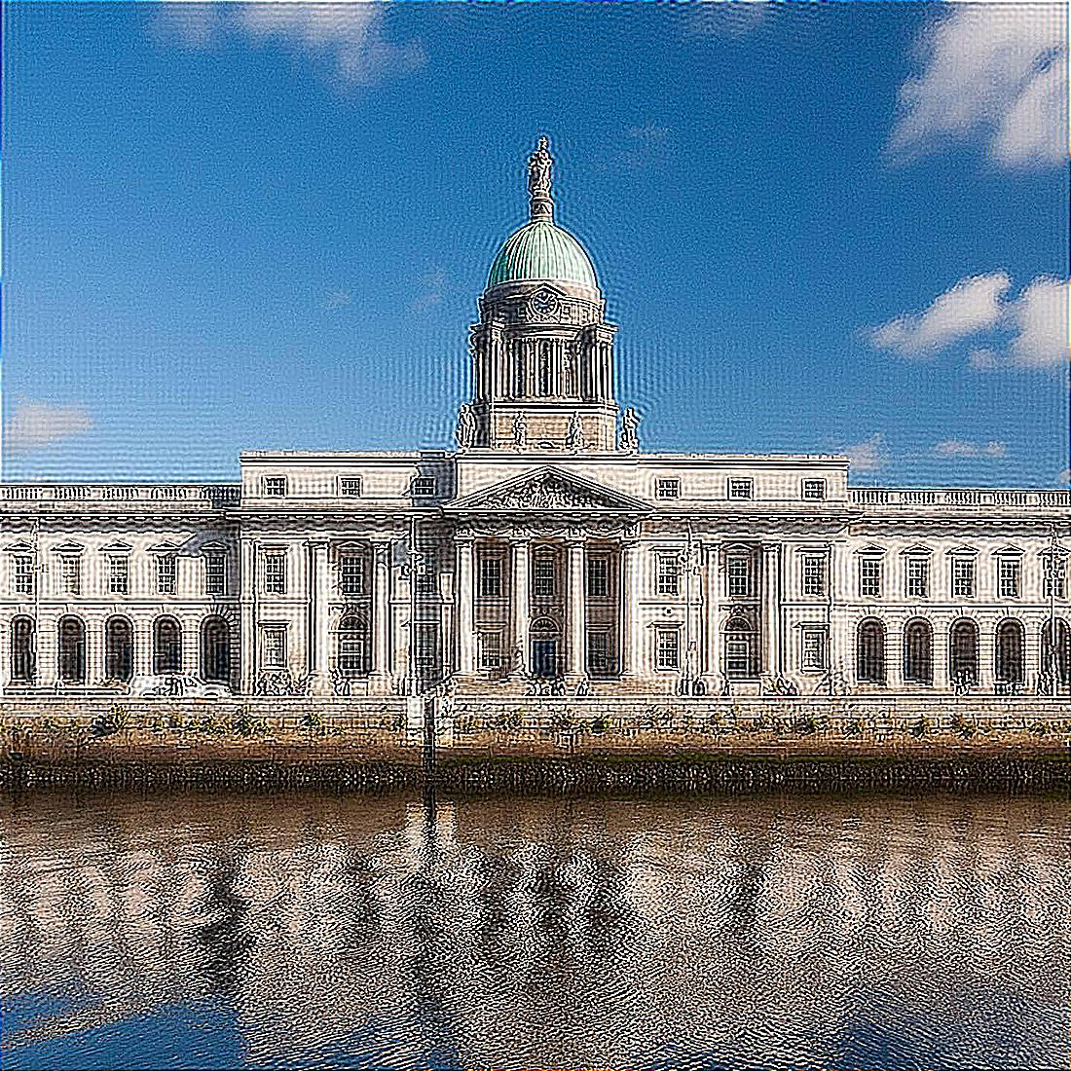
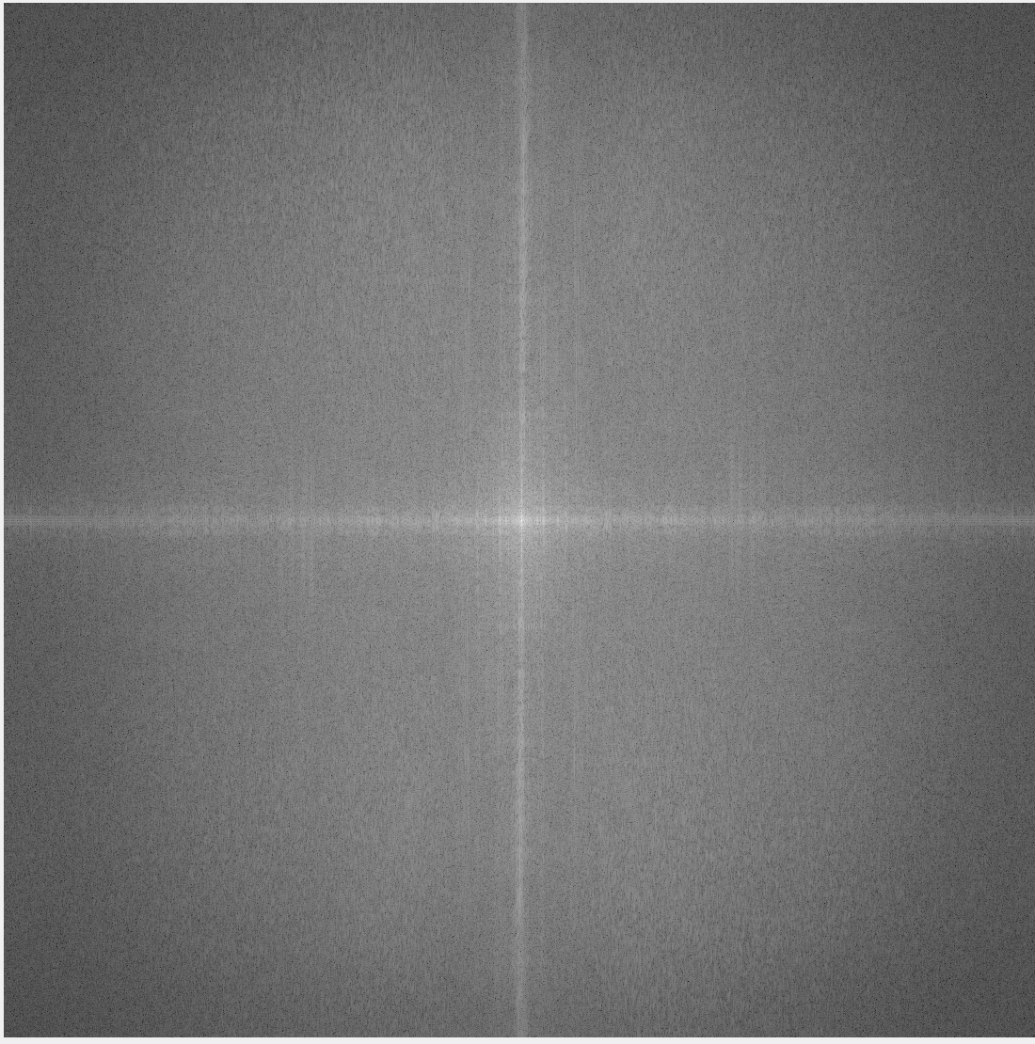
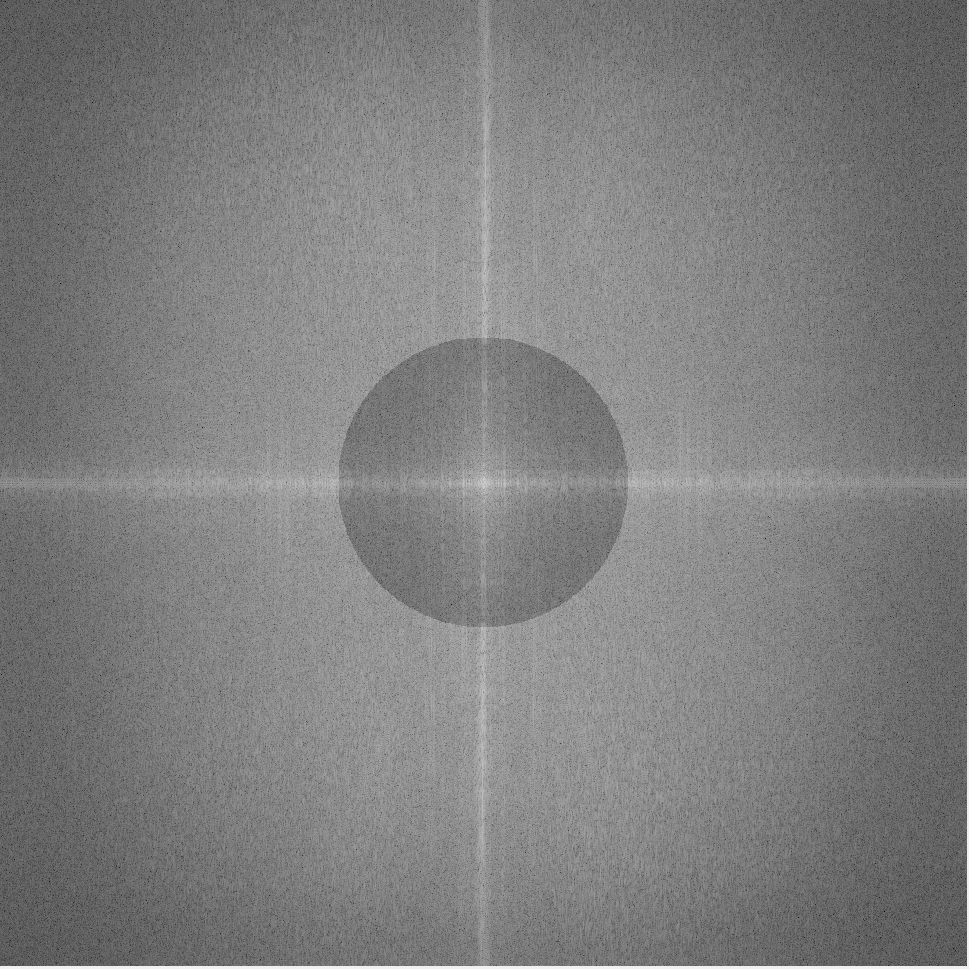
Related Work
Fourier Transform
Spatial Domain
Frequency Domain

Slide 32
Related Work
Fourier Transform
0
Rectangular Function
Signature Function

Slide 33
Related Work
Fourier Transform
Adjust the frequency domain
Exchange the magnitude and phase

Slide 34
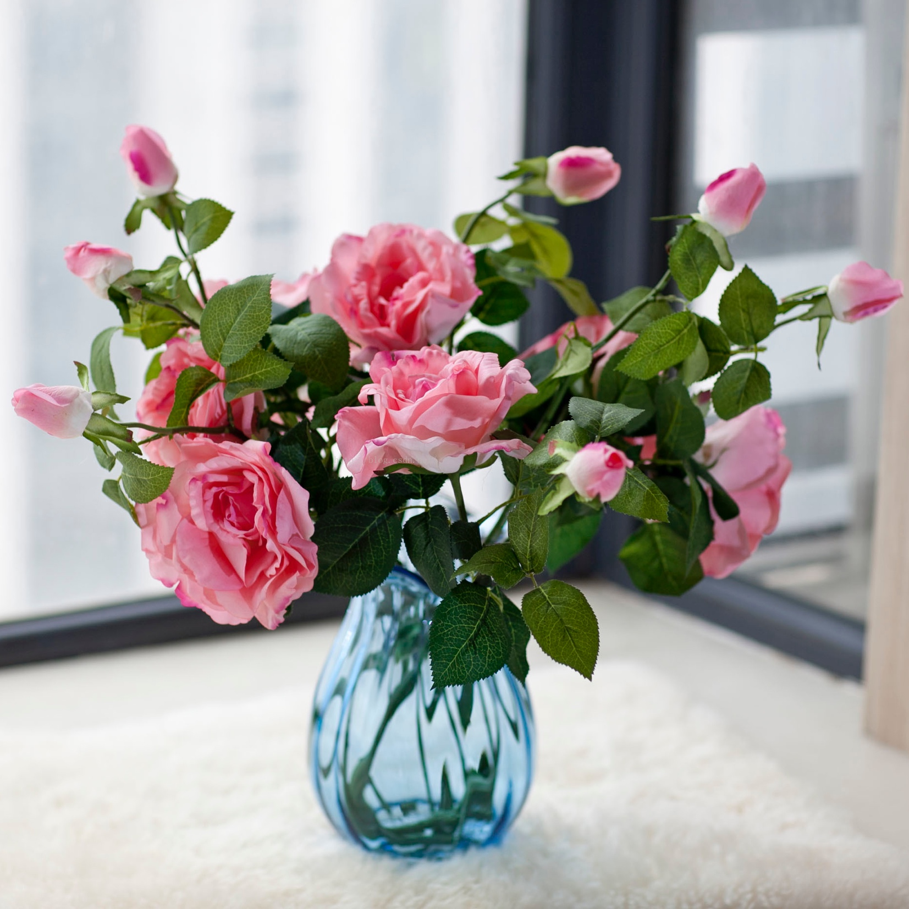
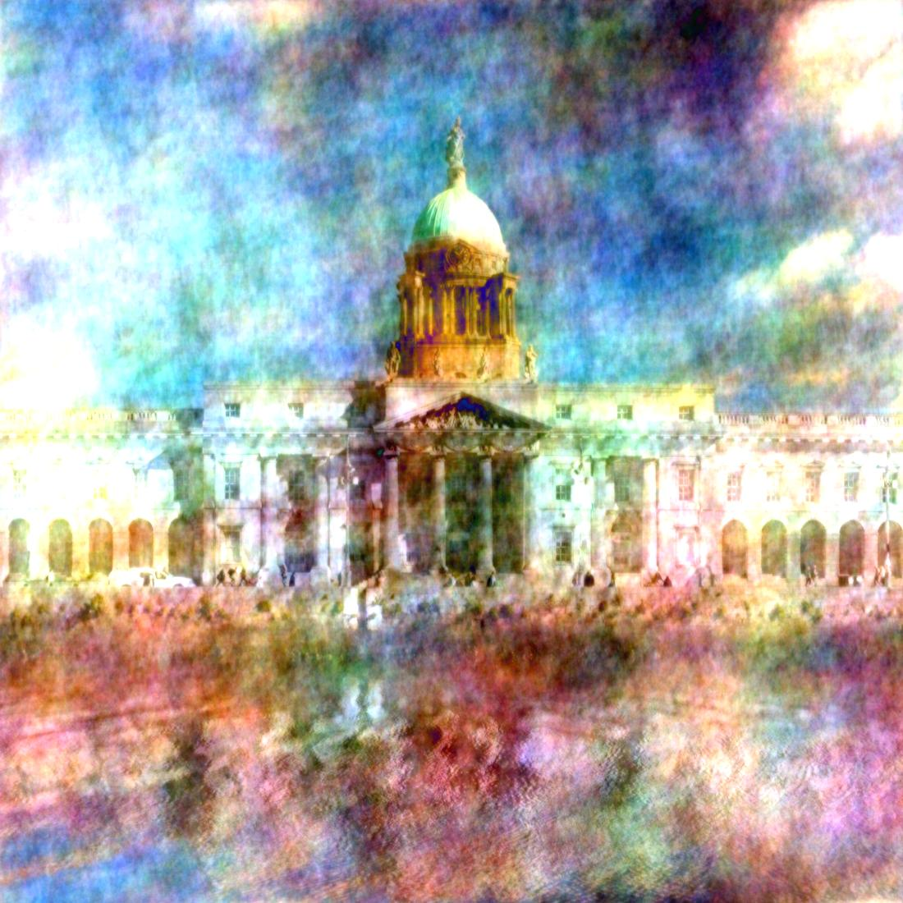
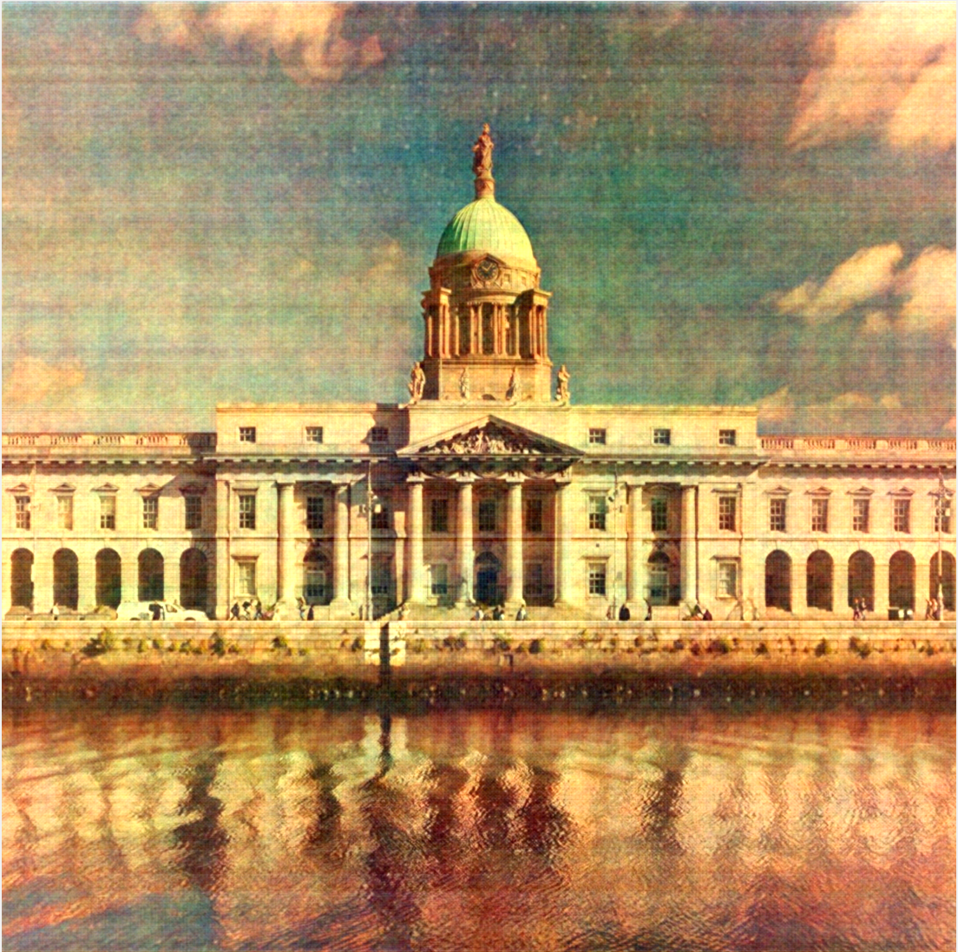
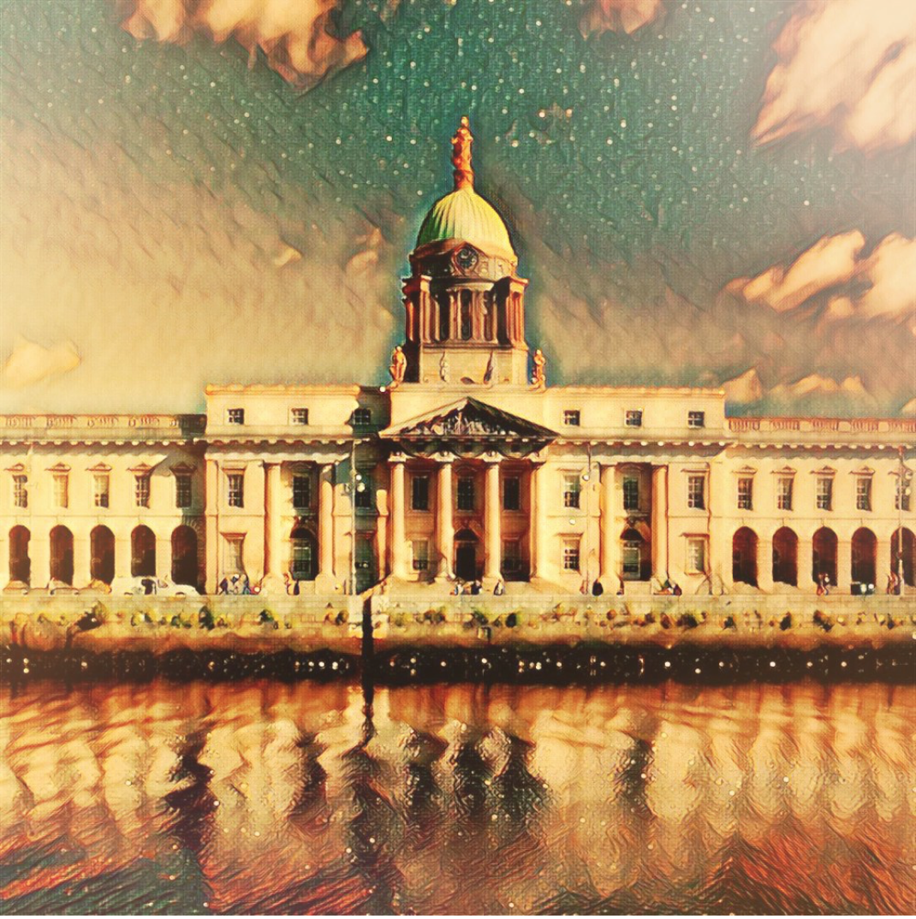
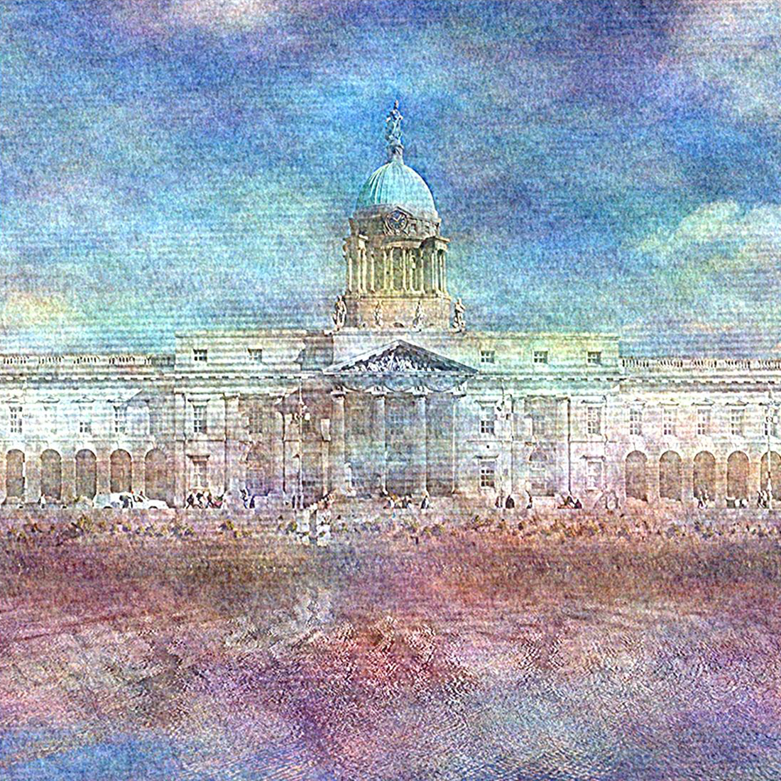
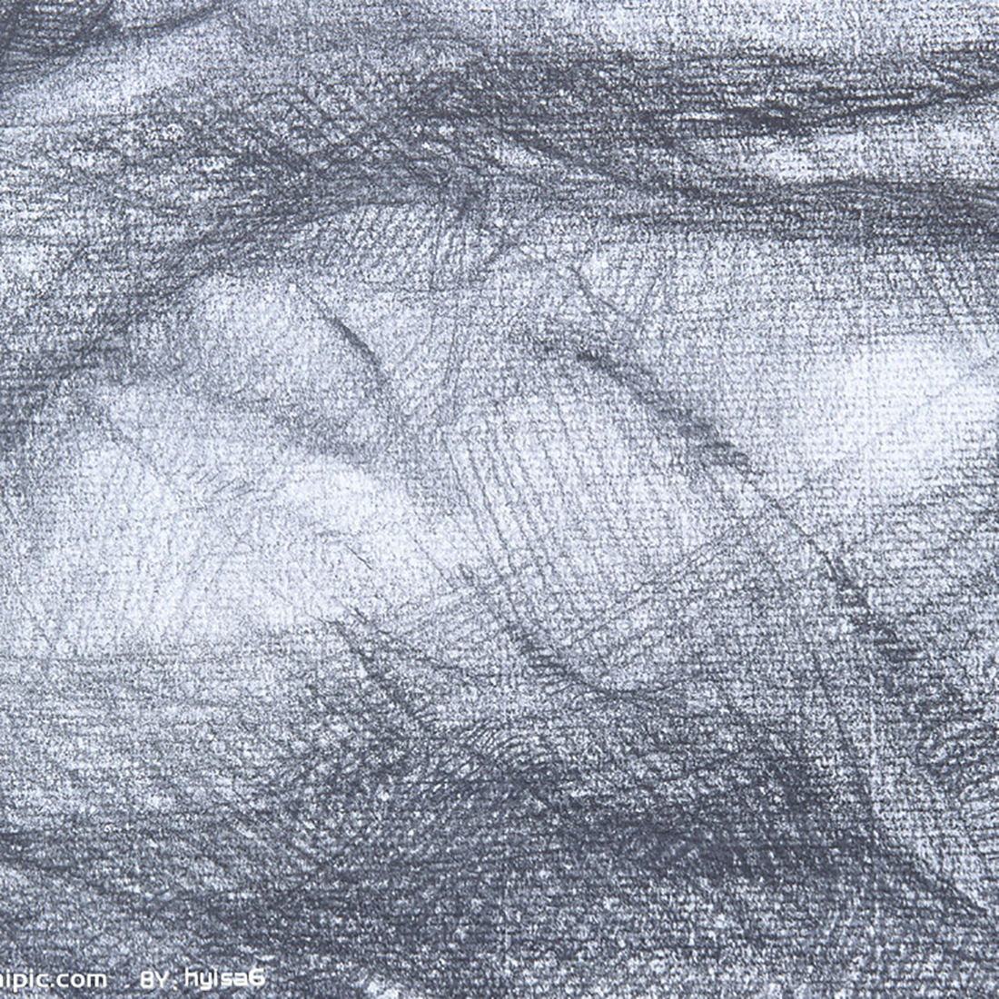
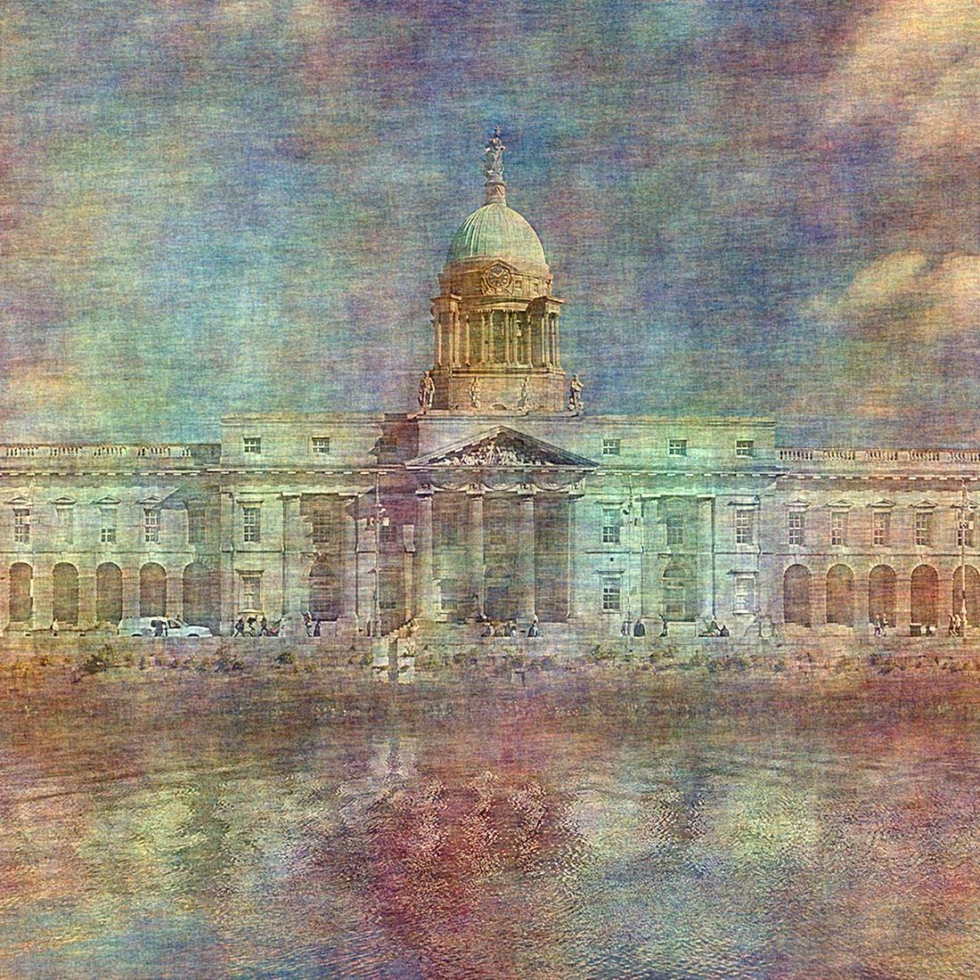
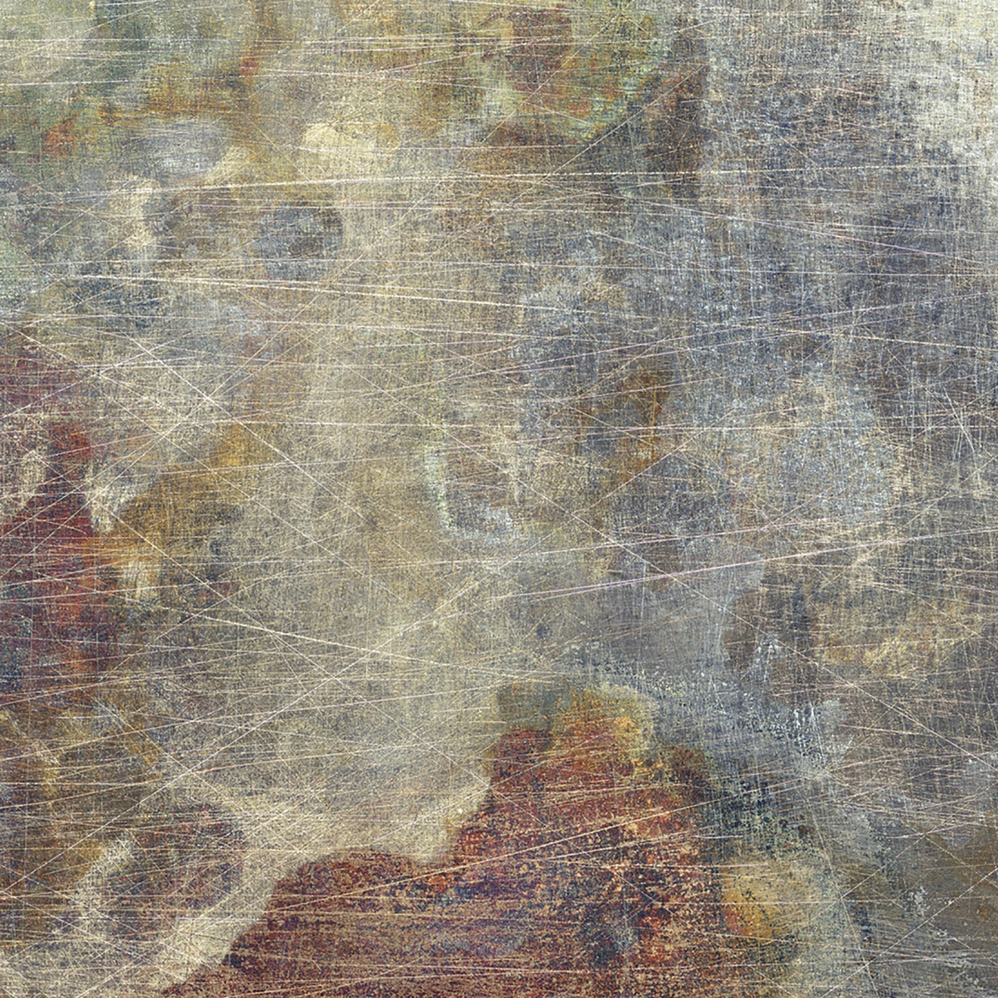
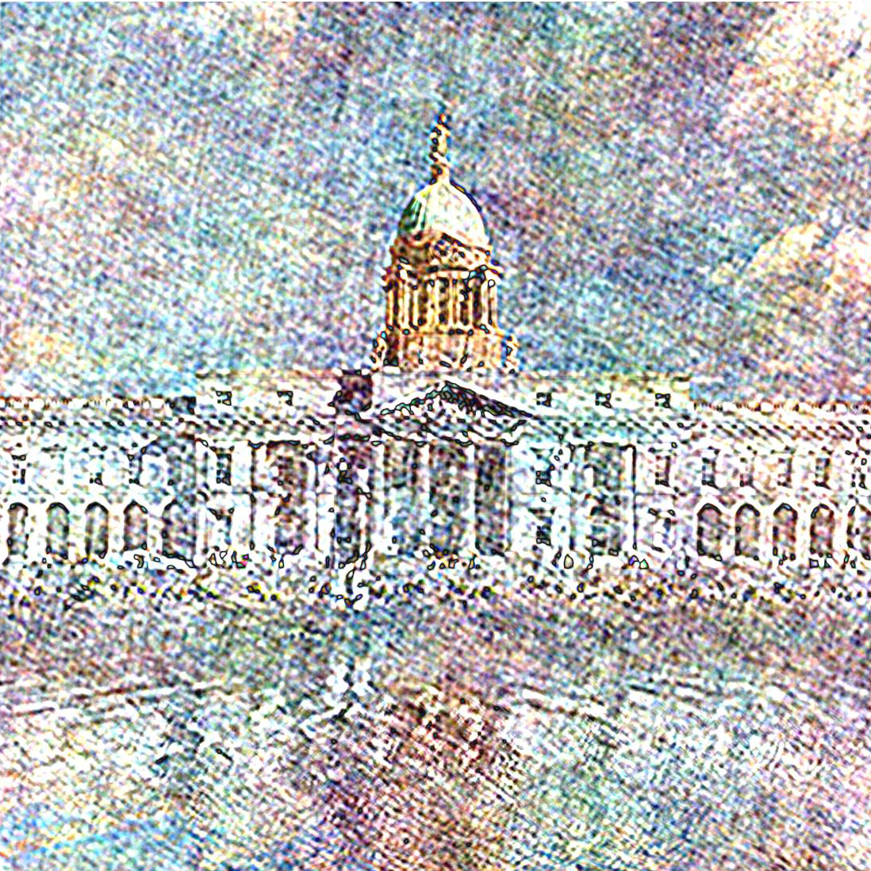
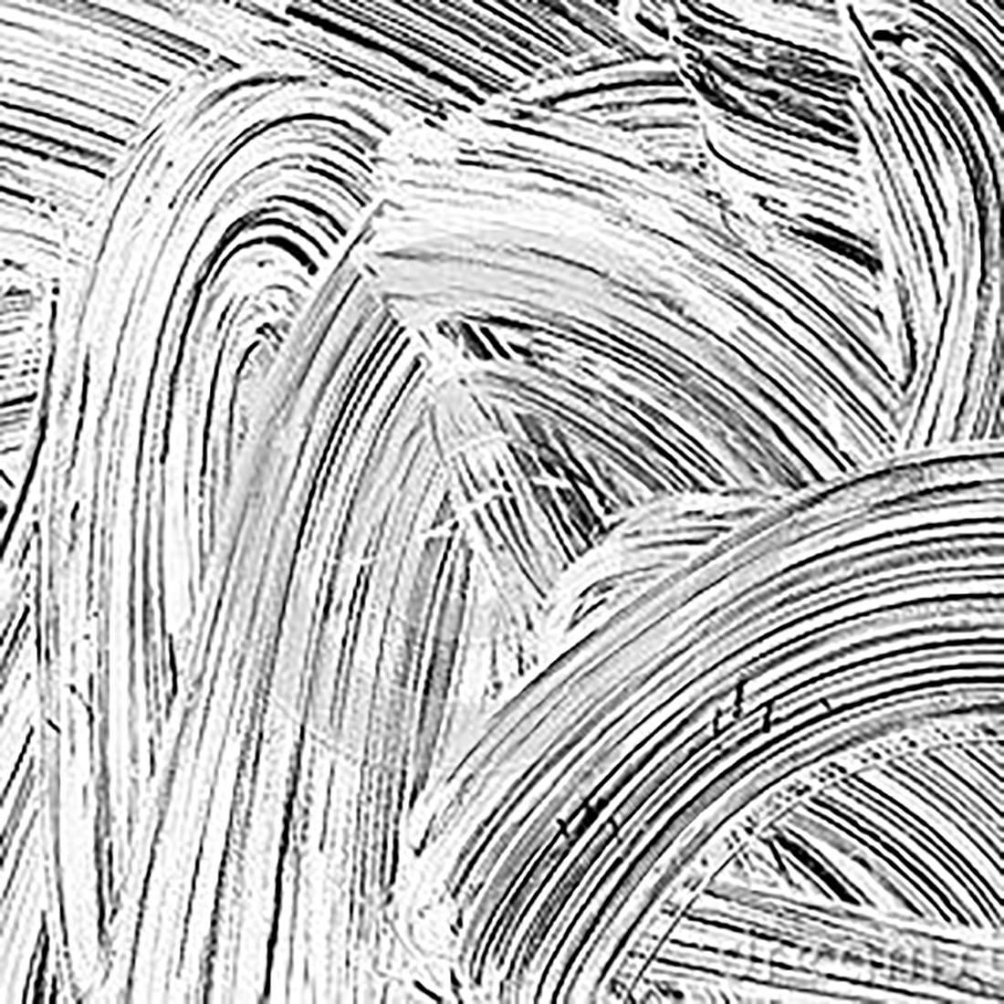
Related Work
fly4.jpg
Fourier Transform
Phase
Magnitude

Slide 35
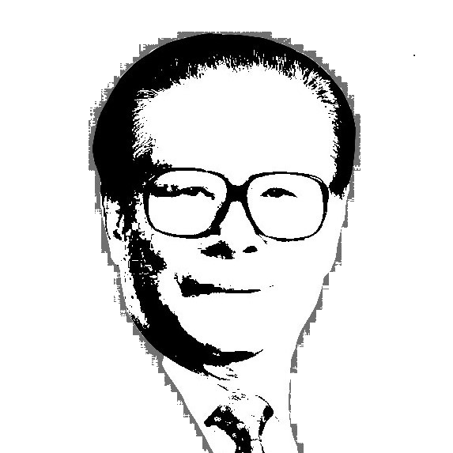
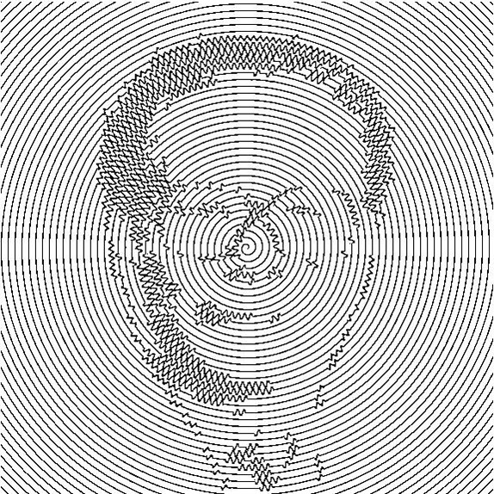
Related Work
Fourier Transform
$$r=A∙θ+f\left(θ\right)∙B∙\sin\left(2πrθ/λ\right)$$

Slide 36



Related Work
Fourier Transform
Phase
Magnitude

Slide 37


Related Work
Fourier Transform
0

Slide 38
Related Work
Smash filter
Smash filter

Slide 39



Related Work
Smash filter

Slide 40

Related Work
Smash filter
Image tool box
&
Resize() function

Slide 41


Related Work
Smash filter
If the pixel isn’t black, change with the pixel in the original picture
Original picture
If the pixel is black, keep is as black.
Smash material

Slide 42

Related Work
Smash filter
Same way

Slide 43

3
Pipeline & Final work

Slide 44
Pipeline & Final work
Dirty
Filter
Saturation
Enhance
Oil
Painting
Add
Texture
Outline
Yellow
Filter
HA
Transform

Slide 45







Pipeline & Final work
Add
Texture
&outline
Dirty
Filter
HA
Transform
Yellow
Filter
Oil
Painting
Saturation
Enhance

Slide 46
4
Weakness & Improvement

Slide 47
Weakness & Improvement
1
Lack of GUI
2
Considerable time-consuming in oil painting
Notes:
1.Color space include: RGB HSV LAB

Slide 48
Thanks

